Slide 1
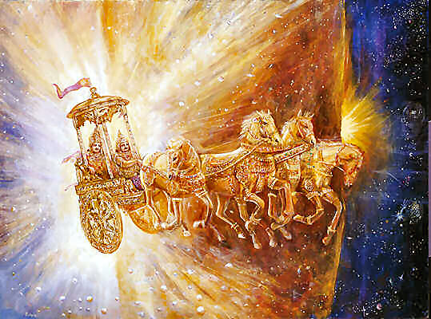
Dr. Valdis Steins Rituals, Temple and Priesthood

Slide 2
Ritual Structures – Constituent Parts
Divine
Saint Place – Temple
Folk
Priesthood

Slide 3
Divine & Perfection of God
Dievs - Devas – single God for Latvians
Avatars of God – personification or fictions
Pantheon – for other Folks
Latvian God has very high Perfection level without any idolatry and idiolatry
Latvians cannot show how the God looks - no monuments, no pictures, no frescoes, because it is pure universe divine field-structure and Logos

Slide 4
Saint Place – Temple or Lodge place for rituals
Natural energetic place – grove, tree-solitary, stone, cliff
Artificial place, made saint by priests or people Egregor (information - energetic aura)

Slide 5
What is Temple? 4 parts - elements
Meeting place with God, Ritual place
Artificial Building made saint by priests or people egregor, or natural place: Tree-solitary (oak), Grove, Clif, Stone, underground energy line crossing points (water, «fire», gravity) Cosmos energy receiving points.
Priests
People
============================
For not ethnic religions also
Bank, money change, library, shop, restaurant

Slide 6
Folk structure - Varnas of Latvians & Sindians
Sindia - Invaders changed Varnas into Castes (Potuguese term). Varnas in Sindia were self-defensive institution. Brahmin’s son is brahmin, and etc. Everybody come to this World in specific Casta- Varna.
Latvian Varnas - everybody has its own Darma and accoording to his Darma everybody could get in his Varna. If you are brahmin this does not means that your son will be in Brahmin Varna.

Slide 7
Latvian Varnas
Bramaņi - Brahmins - Noocracy
Labieši – Meritocracy (modern directors, managers, officers, etc....)
Ludi – ļaudis – free Man (human) – patricians
Out of Varnas: izgoji, vārgi - Slaves, Sclovorum, servants – nowdays wage slaves

Slide 8
Aryan (Latvian) Priesthood
Round Table – Row in Circle - «White Corona» – «White Corolla»
„Baltais Vainags” (situation today)
1.group - Spiritual & Ritual priests
2. group - Wisdom priests
3. group - Spiritual & Physical Healing priests
4. group - Forsee or Forecast priests
Out of Circle = Dark Priests

Slide 9
1.group Spiritual & Ritual priests (Sanskrit -Latvian and English language)
Vaideloši and Vaidelotes – International Rituals managers, spiritual „fathers” and „mothers”, roman catholic cult have Black and White Pope, occultists have High commissars, Adam Race nations have – High Priests & Judges, but Latvian priesthood do not have vertical hierarchy
Local Ritual managers - Vīkšēji un Vīcēji
Agni priests – Saint Fire ritual managers, similar to Zoroastrians, including Hirpi or fire-leaping priests. For example – we found such priests in Falisci folk (nation) in Italy , but we have them up to date in Latvia.
Aque (water: aqueous) ritual purification priests - “Spring- Fount Priests”.

Slide 10
2. group Wisdom priests
Prātnieki - Sage profound wisdom , thinkers – philosophers - metaphysicians
Burtnieki and Vārdnieki – Lingua priests, language and dictionary developers, language guardians and tutors.
Garīgie Ceļveži – Spiritual Guide, typical Noo-cratos.

Slide 11
3. group Dziednieki –Healing priests
Zintnieki/ Krīvi/ Vīki/ Baltā Ragana/ Raganis - White Witch or Wicca (not mixed with Wicca religion). They are spiritual and body healers, and also predict and show the path and guide in pathway.
Healers (homeopathic, energetic, remedy and many other specialists and variants, each healer is unique).

Slide 12
4. group Reģi - Forsee or Forecast priests
Gaiš-reģi - Seers – Oracle, divine the future
Pareģi - Augurs
Pareģonis–zintnieks - Soothsayer – predictor, prognosticator, all predictions are based on special knowledge
Zīlnieki - Fortune-tellers, today modern name - «extrasensory priests».
Tāl-reģi - Clairvoyant – perceiving things beyond natural range of sense
Laika veči - Weather and Calendas priests
Zvaigžņu tulki – Astrologers
Pravieši – Prophets

Slide 13
Aryan - Latvian – Etruscian Fortune-teller (backside of etrusci Mirror)

Slide 14
5. Out of Row – Out of Circle = Dark Priests
Zavatnieki – Para-witches
Magi – magic & occult– „Dark priests”- satanists
Spīdolas/Spīganis/ Malduguns priesteri - Will-o’-the-wisp/ fake torch-bearers

Slide 15
Latvian research kinship Folks – 1. etruscans, umbrians,

Slide 16
Latvian research kinship Folks 2. – piceni, osci, liguriana (ambroni- Ambrone), , old-venetians

Slide 17
Latvian «relatives» in Sicily = Elymians – Elimi, Sicani – Sīkaņi and Sicels - sīkuļi

Slide 18
Latvian Avatar Jumis (twin spike-ears) on the Falisci picture (350/25 BC)

Slide 19
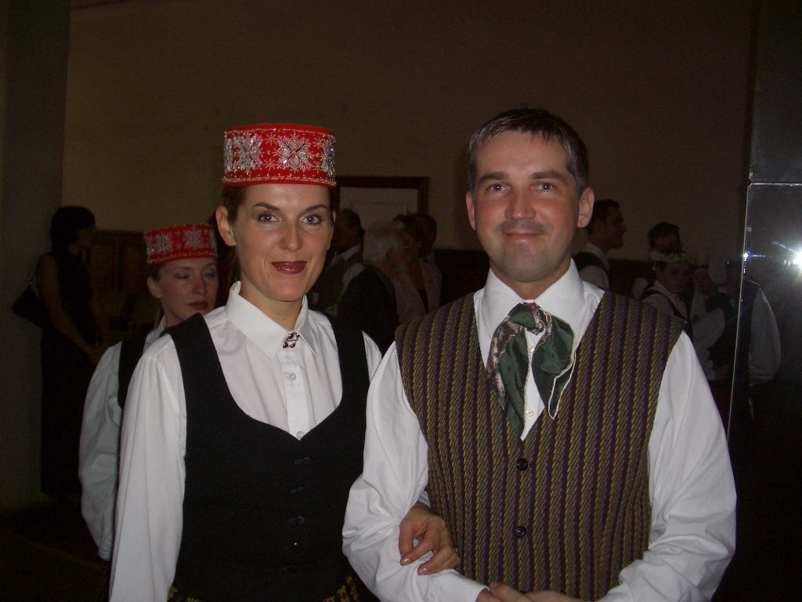
Etruscans and Latvians

Slide 20
Young Etruscan

