Slide 1
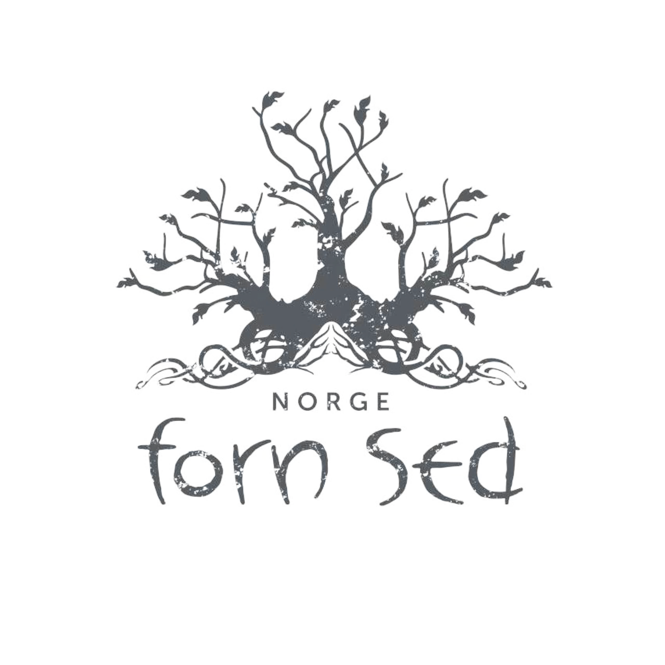
Forn Sed Norge
(Old Ways Norway)

Slide 2
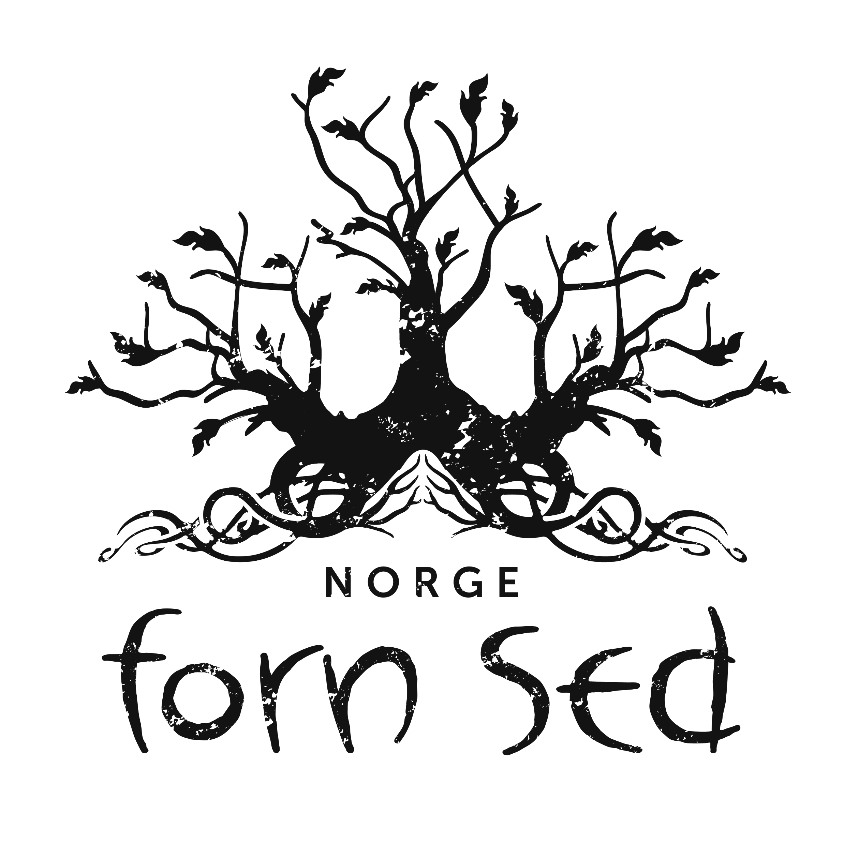
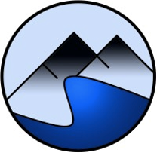
About Forn Sed Norge
FSN started in 1998, and got its government approval in 1999. We`re twenty years this year!
We were first called Foreningen Forn Sed (The association Forn Sed), but changed this some years ago. We also got a new logo after a contest between our members.

Slide 3
The purpose of the association is:
To act as a contact network for members of the association and followers of the old practice.
to create a viable forum for anyone who wishes to carry on old traditions and customs, as well as contribute to a understanding and interest in the Norse cultural heritage.
FSN was founded with the idea of a democratic system without a religious hierarchy. The idea was that each member could participate equally. Historically there wasn`t any secret society, or grand titles and fancy positions in the faith. And we believe this is how it should be today also.
The annual meeting, where all members can participate, is the top of the organization. The annual meeting lays the foundation for the following year. This is where the board and other important roles is set. The board handles the daily functions of the organization.

Slide 4
Since we recognise the Norwegian state as our supreme authority, and submit to its laws, we don`t need many rules. But we do have some specific to us:
The main content of the pagan tradition is that every person is responsible for themselves and their actions
It is allowed to holy pictures and statues of the gods and other signs of the powers, but it is not a duty to worship these.
It is a bad practice to disgrace gods or other things that are holy. This means that you must show respect for the gods statues, hov and horg (places of rituals), as well as ancient monuments.
It is allowed to inform others about the association and the old practice, but organized missionary is unnecessary and should not occur.

Slide 5
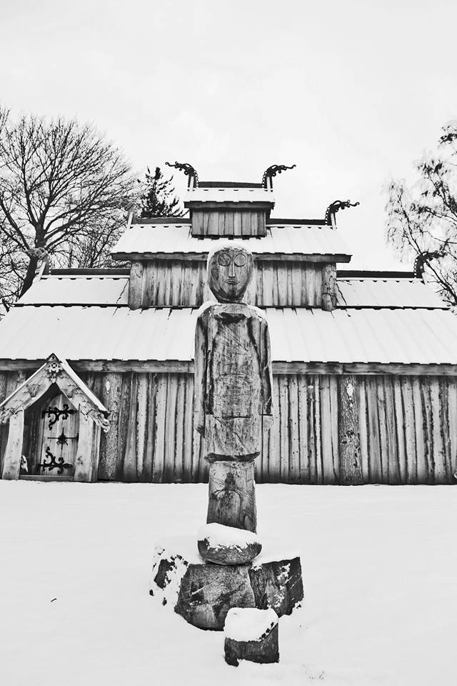
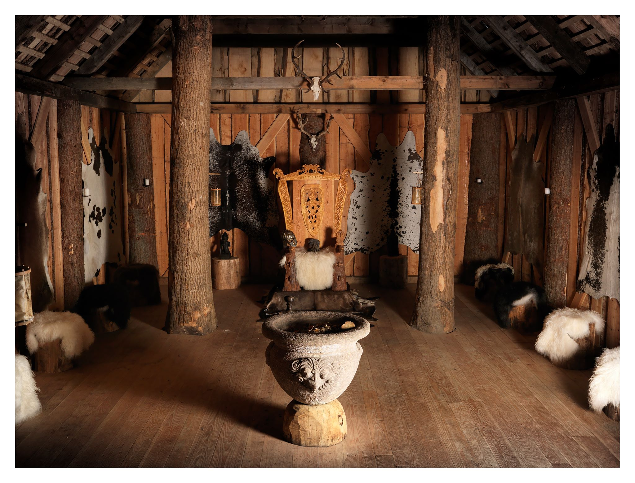

Slide 6
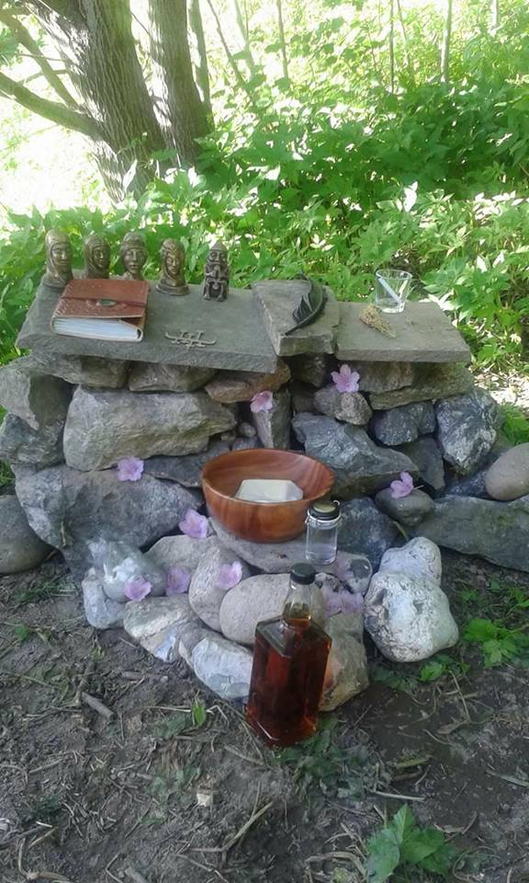

Slide 7
We`re a non-political society. But Sometimes we have to engage anyways. Ranheim ve was one of those cases. In Trondheim there was discovered a holy place from the Iron age during a build of residential homes. This was the only one of its kind found in Scandinavia. The government excavated it, and then claimed it could not be protected as a ancient monument since it was already disturbed. We think they broke the law that says cult places older than the year 1537 is automatically protected. We reported it as a misconduct by the Directorate of Cultural Heritage. They sadly didn`t agree.

Slide 8
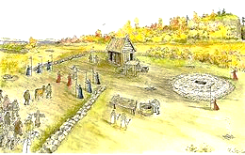

Slide 9
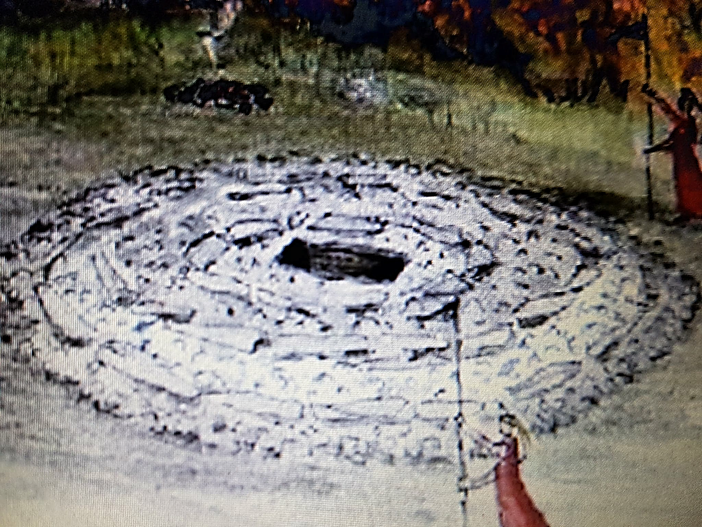

Slide 10
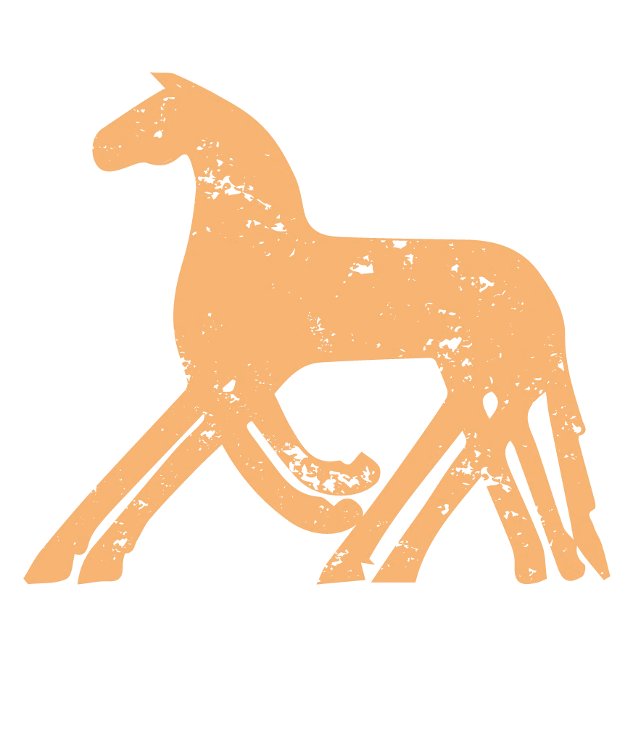
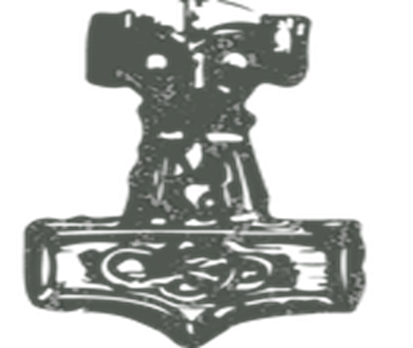
What do we believe in?
Our members practice their own religion as they find suiting for themselves, as long as it is not forbidden by Norwegian law.
We recognise all gods and spirits within Norse mythology, for example:
Æser, diser, vaner, jotner (Viking gods and goddesses)
elf’s, dwarfs, trolls, nisser, huldra and other beings in nature
Sun, moon
Ancestors, fylgja (spirits following and helping individual people)

Slide 11
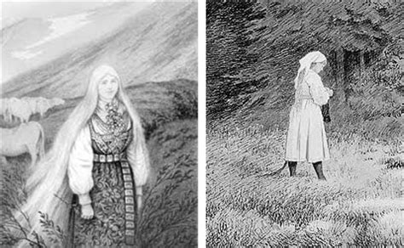
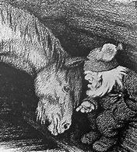
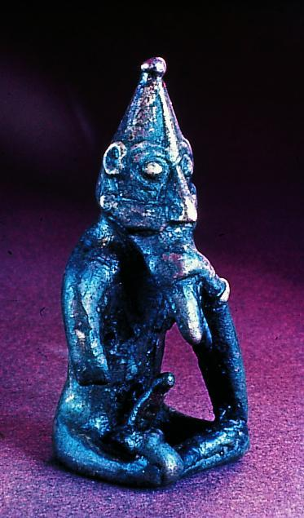
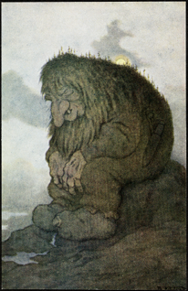
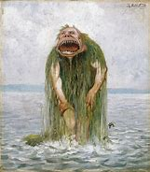
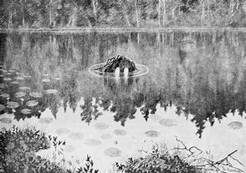

Slide 12
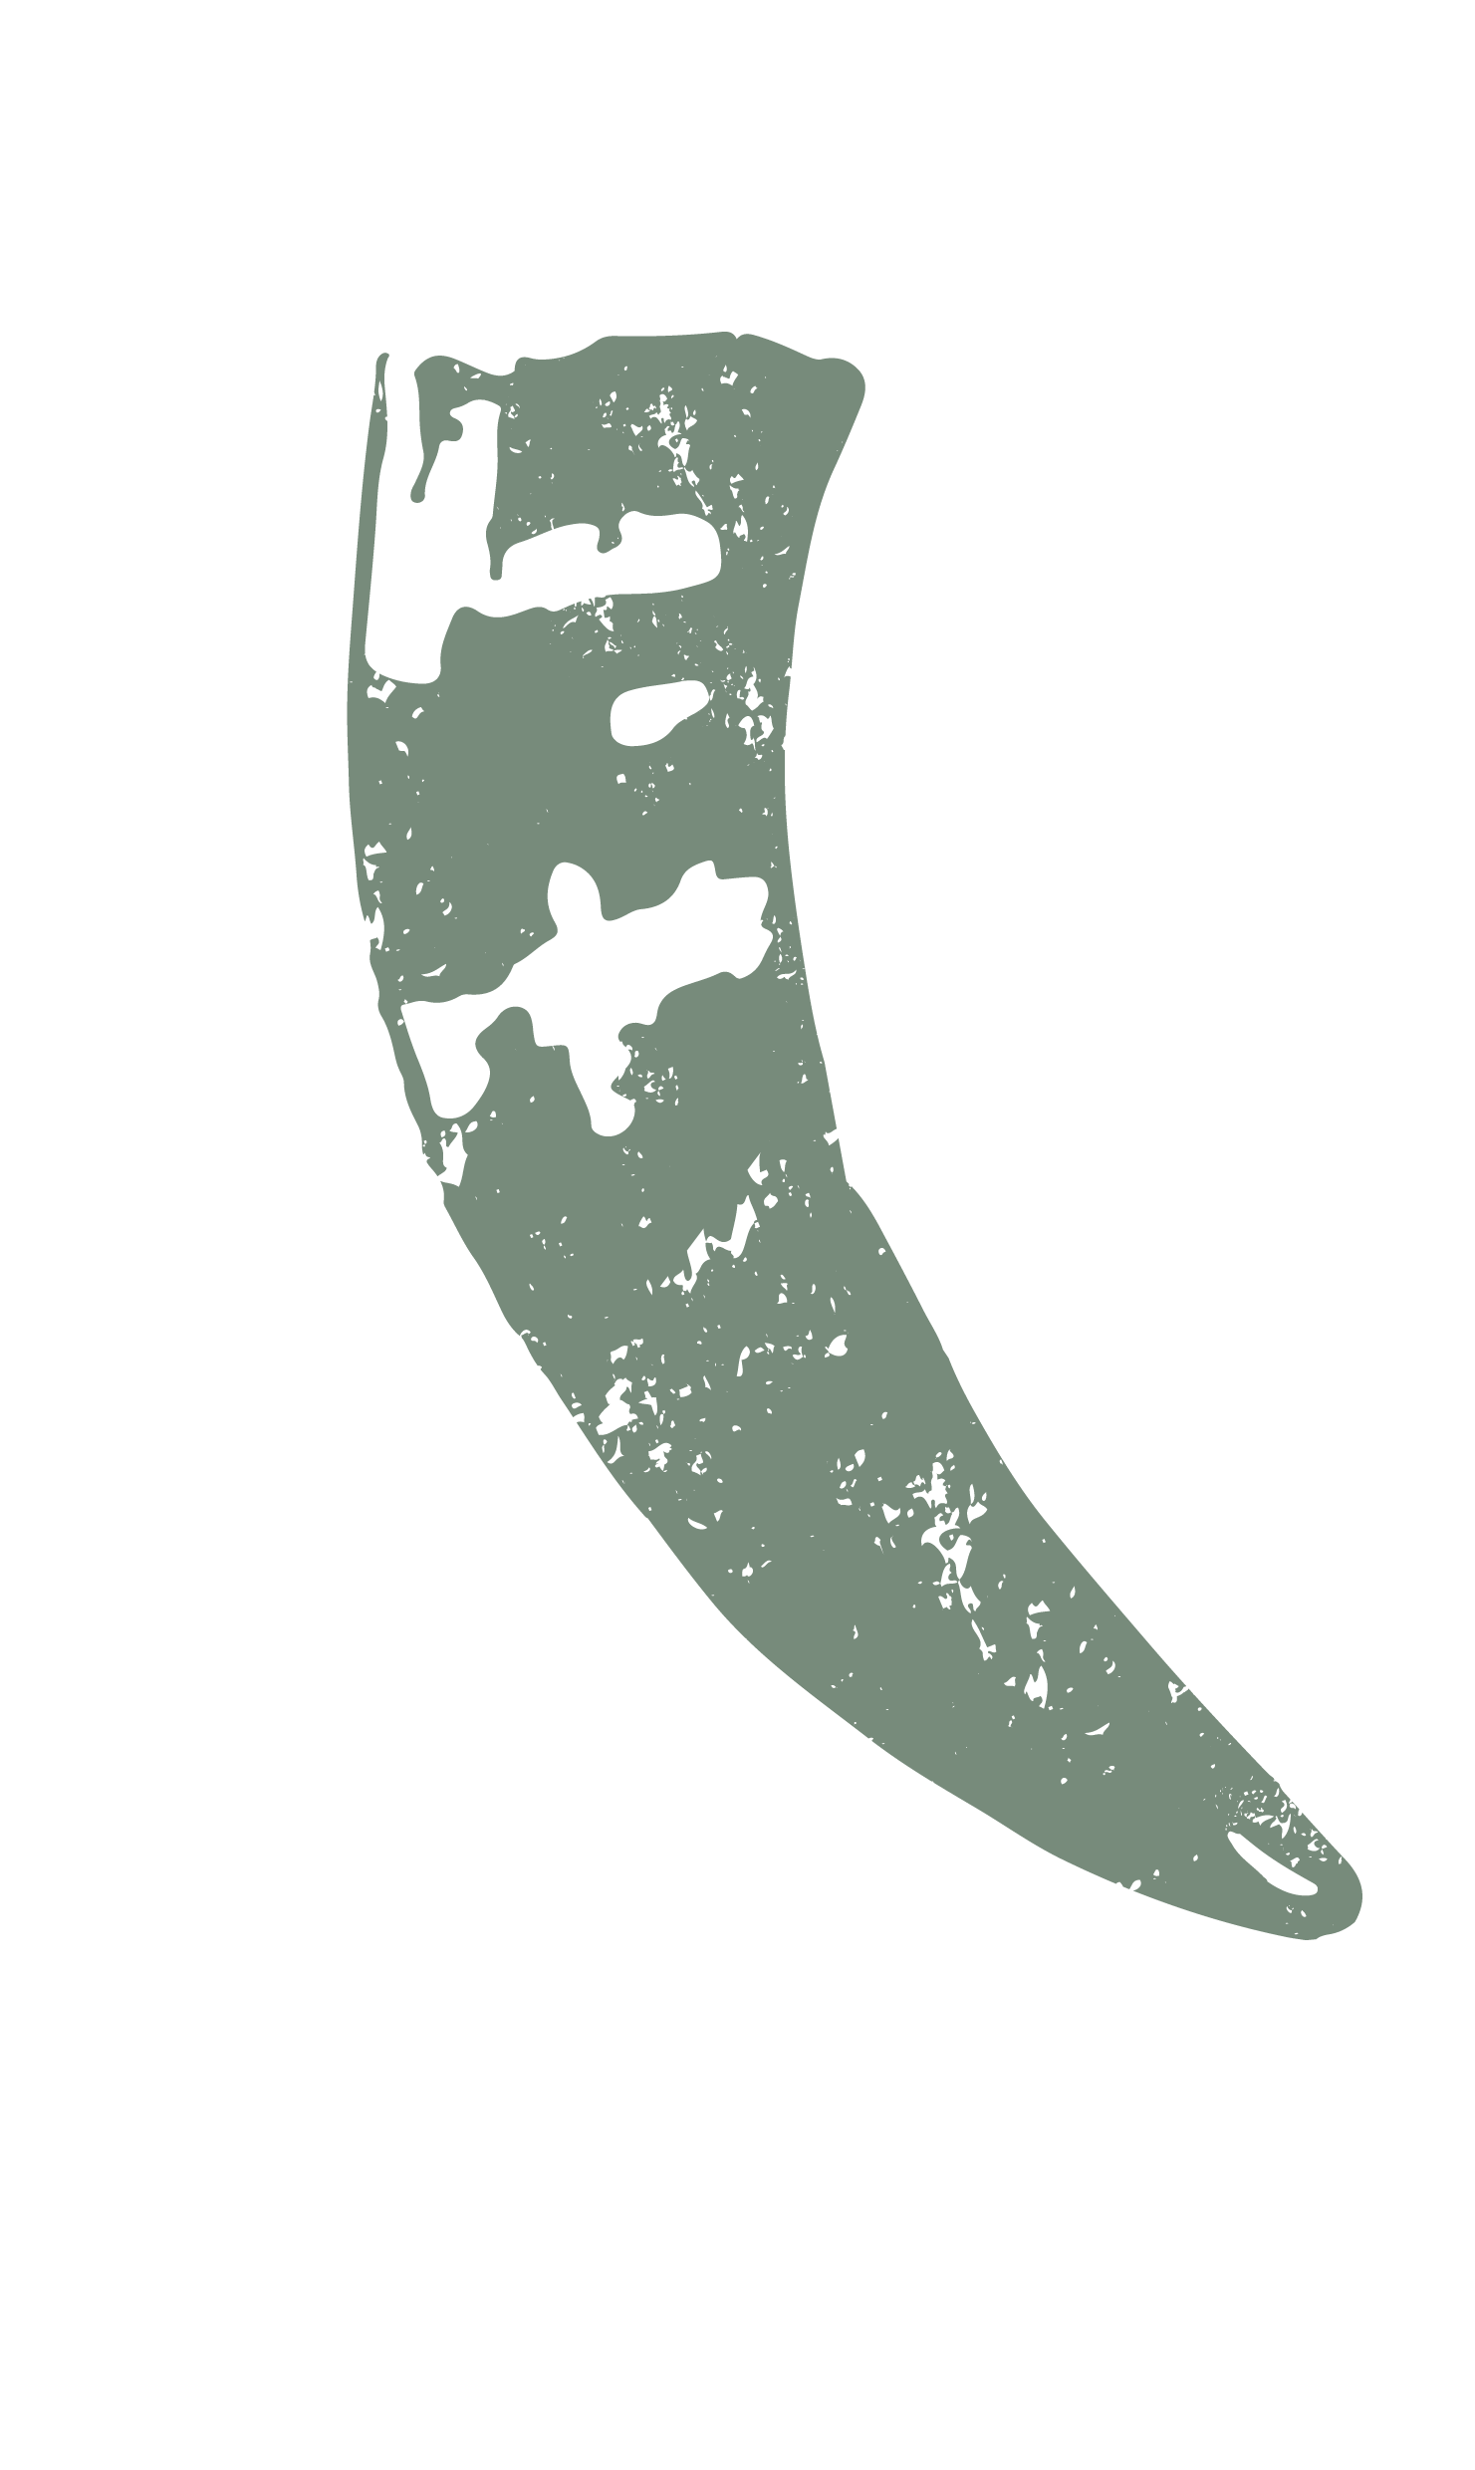
What do we offer our members?
The leader of the board can perform legal weddings.
We offer a ceremony to name children, and to bring them in to their family line.
We have also made a new ritual for youths to transition into adulthood, as an alternative to the Christian confirmation.
We are developing a ritual for funerals.
We`ve had some social meetings
We publish our members magazine, Ni Heimer.

Slide 13
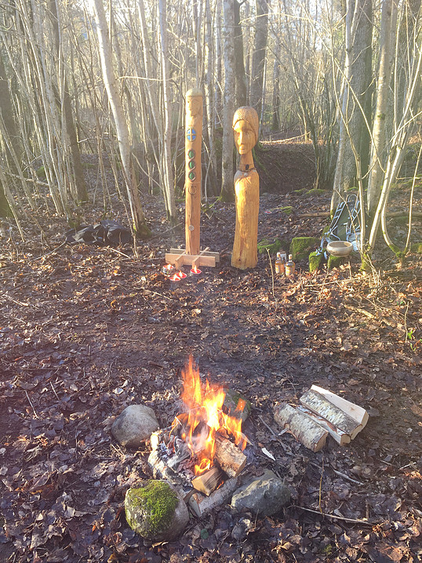

Slide 14
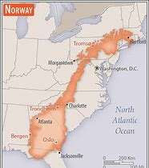
We have four blots (offerings) every year, one for each season. In the summer we try to make it a whole weekend with some choruses, music and good food. But the length of Norway causes a big challenge. Our country is long and full of high mountains and deep fjords. The longest part is 1 692 kilometres by air. If you want to travel that distance without leaving Norway, it`ll take one day and a half without stops. Although Google maps won`t even suggest that route. Here you see Norway compared to the east of USA

Slide 15
Our (other) challenges
We are 124 members, out of these there are 110 approved ones. This means that 14 of our members is also member of some other organisation or lives abroad. Every year the church double registrates 10 % of our members without their knowledge.
The state itself also tries to counteract small religious organisations like us. A proposition to deny every such organisation under 500 members (and for members below 15 years of age) financial support was stated last year. Just weeks ago they decided to wait until next year to vote on it.
Racism and the misuse of Norse symbols by far right extremists can make it hard to be an open follower of the old faith.

Slide 16
What`s new?
We have a new statue of our goddess Frigg.
Some of us have been on a TV show about religion on the national tv channel.
As said, we have a new youth ritual, and a funeral ritual on the way.
We got a new webpage, https://www.forn-sed.no/

Slide 17
